Slide 1
CCO PMO Project Kick-Off

Slide 2
Meeting Agenda
Project Team
Project Overview
Next Steps

Slide 3
Project Team
Project Team Member | Project Role
Tonya Brunson | PMO Executive Sponsor - P
Kevin McLaughlin | Executive Sponsor - P
Liz Denlea | VP, Technology Operations - P
Shanon Speak | Operations Director - P
Deanna Neal | Leader, Customer Solutions Training
Annastasia Bell | Director, Customer Operations Support
Amanda Boyer | Director, Human Resources - P
Sandy Dunlap | Director, Learning & Knowledge Solutions
Stephen Gillmore | Customer Solutions Communications
Notes:
Resize as needed; for especially large teams, create a second page.

Slide 4
Project Overview

Slide 5
Project Overview Why Are We Here?
Rollout Automated Quality Management(AQM) results using Verint performance management to all CCO units that use Verint recording
Automated Quality as an agent coaching tool.
Supervisor-Management utilizing agent Verint performance management scorecards

Slide 6
Project Overview Project Completion Criteria
Scope: Rollout AQM to all CCO units that are being recorded using Verint.
Operational AQM reporting for AQM dashboard.
Out of Scope:
Ad-hoc Quality reporting
Integration with external applications

Slide 7
Project Overview Project Factors
Dependencies
Training facilitation availability
Verint recording (OFS is in transition to Verint)
Assumptions
Agent and supervisors have access to AQM forms and performance management application in Verint.
For this phase, no Technology requirements
Constraints
Reporting is limited to views from data in Verint application

Slide 8
Project Overview Project Factors continued
Risks
Issues

Slide 9
Project Overview Requested Plan Dates
Project Milestone | Plan Date
Approved Scope | 9/30
Define Requirements | 10/5
WBS | 10/11
Project Schedule | 10/18
Requested Go-Live | 12/1
Plan Dates = Estimated milestone targets established during the Plan Phase – dates are considered 70-75% accurate.
Re-Baselined Dates = Committed milestones established during the Design Phase with particular emphasis on the go-live(s) / release(s) – dates are considered 90-95% accurate.

Slide 10

Q&A

Slide 11

Backup slides

Slide 12
Responsibilities and Expectations Project Team
Meeting Attendance
Be present during team meetings – and speak up
Be on time. Inform PM if cannot attend
Issue, Risk, Change Communication
Identify issues and risks as they are discovered
Communicate issues and risks to PM
Communicate all project change requests to PM
Project Communications
PM can only manage what they are aware of
PM’s job is to run interference FOR YOU and to remove roadblocks
R&R Notification
Advise of R&R as far in advance as possible
R&R impacts project progress and needs to be accounted for

Slide 13
Responsibilities and Expectations Project Sponsors
Project Decisions
PM can only manage what they are aware of – include in project-related discussions occurring outside of project’s established forums
Issue and Risk Management
Help remove roadblocks that are or may impact project
Leverage team meetings and / or weekly portfolio meetings
Weekly Dashboards
Dashboards convey a lot of information in a small amount of space – they are intended for a broad audience
Sponsor Approvals
Scope Document
Change Requests
Project Design
Production Go / No-Go

Slide 14
Responsibilities and Expectations Communication Approach
90% of the PM’s role is to communicate
Typical project communications:
Communication | Frequency | Vehicle | Audiences
 |  |  | Project Sponsors | Project Team | Other Stakeholders
Project Status Meeting | Weekly | Conference Bridge & WebEx | X | X
Project Status Meeting Minutes | Weekly | Email and / or Project SharePoint | X | X
Project Schedule | Weekly or As Needed | Project SharePoint | X | X
Project Issues and Risks | Weekly | Based in Excel or Clarity, (extract) posted to Project SharePoint | X | X | X
Project Status Dashboards | Weekly on Fridays | Email and Project SharePoint | X | X | X
Portfolio Status Report | Weekly (specific to LOB) | Email | X |  | VP’s/Managers
Project Sponsor Meeting | As Needed (bi-weekly or monthly) | As preferred by the Sponsors | X |  | Executive Sponsors

Slide 15
Responsibilities and Expectations Escalation and Decision Process
For any action item, issue or risk that a project team member has, the first point of escalation is your Project Manager
The Project Manager (PM) should work with their project team to first develop possible options for resolution before escalating up the chain
The PMO Director can assist as an escalation point for technology-related issues
If your action item, issue or risk is preventing you from progressing towards a key deliverable date that will impact the project schedule, the item should then be escalated for intervention and resolution
If the team cannot resolve the item, the PM should consult the PMO Director and, if needed, begin the escalation process to resolve or reach a decision
Project Team Member
Project Manager
Project Sponsor
Executive Sponsor
BU / SME/ Relationship Manager

Slide 16
Project Management Approach

Slide 17
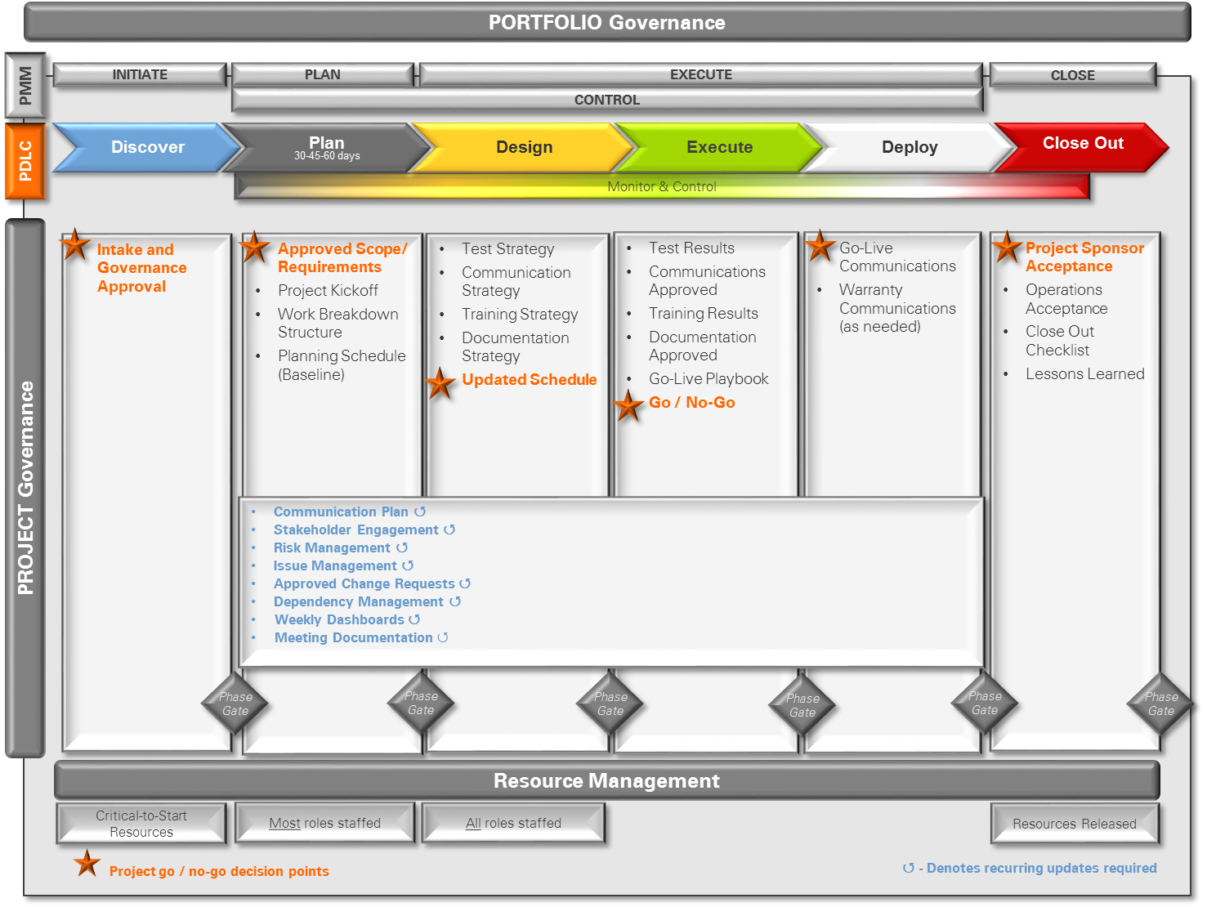
Project Management Methodology Project Delivery Life Cycle

Slide 18
Project Management Methodology Knowledge Areas
Managed Knowledge Areas
Integration
Time
Cost
Quality
Scope
Human Resources
Communications
Risk
Procurement
Stakeholder

Slide 19
Project Level Management Approach
The PMO framework addresses key areas to contribute to project success.
Area | Project Level Approach
Scope Management | PM facilitates the preparation and review of a Scope Document with the project team and facilitates the approval with key stakeholders via review sessions and email. A Requirements Document is addressed in the same manner, appropriate.
Schedule Management | A Work Breakdown Structure (WBS) work session is facilitated with the project team and transformed into a sequenced, assigned by Role and/or Name, time framed list of tasks to effect project delivery, control and closure. The tasks are reviewed with the team at regular intervals and the date/dependencies are used to communicate Planning and Commit Dates.
Dependency Management | Dependency Management is addressed through solicitation, portfolio review, standard status communication distribution and the use of a tracking document.
Risk Management | Risk Management is addressed through solicitation, portfolio review, standard status communication distribution and the use of a tracking document.
Change Management | Change Management is addressed through solicitation, portfolio review, standard status communication distribution and the use of a tracking document.
Reporting | Standard Weekly Status Reporting is established via a populated and distributed template.
Governance and Project Oversight | The Project Quality Review is a session facilitated by an objective third party and includes the project team, sponsors and stakeholders to review and gauge the progress and direction of the project/program, and ensure it is set up for success. Process Adherence Reviews are performed on every project in each project phase. This is a review with the project manager and PMO Director to ensure consistent application of PM framework across projects/programs within a portfolio. Lessons Learned are to assess project/program successes, unintended outcomes and improvement opportunities to inform and improve future efforts. The Customer Acceptance Letter validates that success criteria was met.

Slide 20
Next Steps

Slide 21
Next Steps Planning Activities
Plan Phase:
Recurring Project Status Review Meeting
Plan Schedule

